Slide 1
Scanning tool
ow

Slide 2
sbom
In today’s digital age, every piece of software we use is like a puzzle made of different smaller parts from various sources. A Software Bill of Materials (SBOM) is a list that tells exactly what these parts are.
If there’s something bad in the software, like a security weakness, the SBOM helps us find and fix it quickly, keeping our computers and information safe.
An SBOM can help us find out where the bad part is in the software so we can fix it before it causes problems.

Slide 3
setup
Prerequisites
An AWS account.
Activate Amazon Inspector.
An EC2 instance (aws linux)

Slide 4
definition
A Software Bill of Materials (SBOM) is a complete, formally structured list of components, libraries, and modules that are required to build (i.e. compile and link) a given piece of software and the supply chain relationships between them. These components can be open source or proprietary, free or paid, and widely available or restricted access.
Software producers use SBOMs to help create and maintain the software they deliver. Software buyers use SBOMs to evaluate software before purchasing, negotiate discounts, or plan how to deploy it. Software operators use SBOMs to manage vulnerabilities, track assets, handle licensing and compliance, and quickly identify dependencies and supply chain risks in the software and its components.a

Slide 5
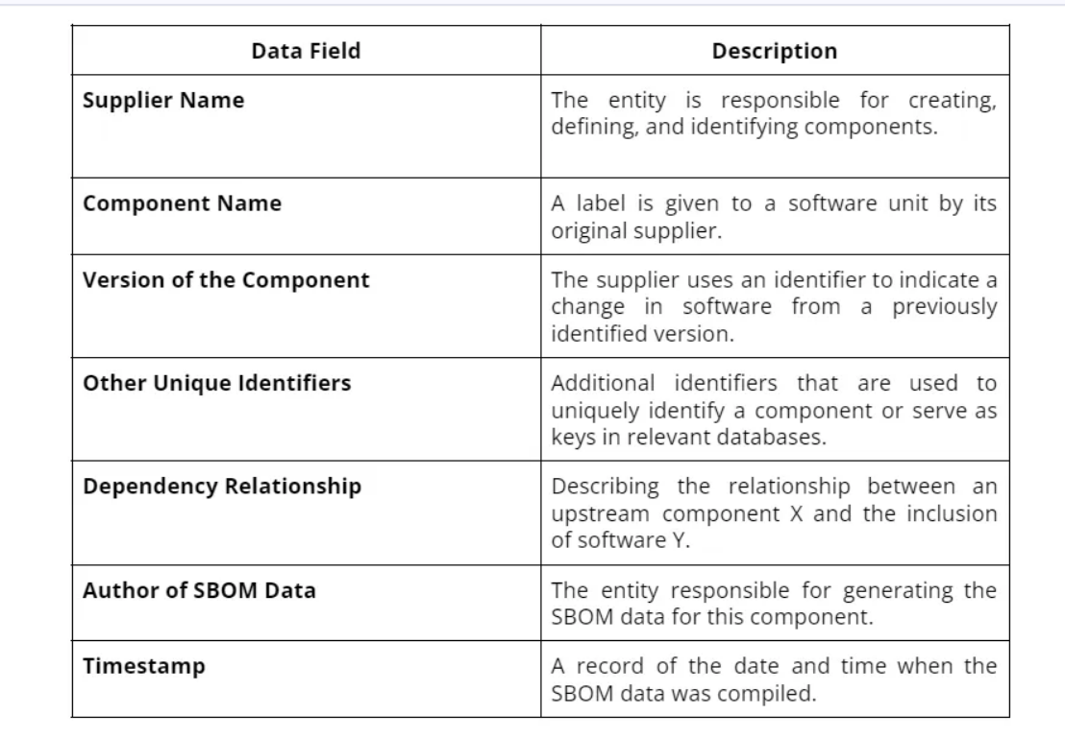
Fields of sbom

Slide 6
Lab for sbom
Setup env
Run test

Slide 7
..
System Package Data Exchange (SPDX®) :An open standard capable of representing systems with software components in as SBOMs (Software Bill of Materials) and other AI, data and security references supporting a range of risk management use cases.
CycloneDX is designed to provide advanced supply chain capabilities for cyber risk reduction.Compatible with over 200 tools across 20+ programming languages, CycloneDX is trusted by Lockheed Martin, ServiceNow, IBM, Contrast Security, Sonatype, and many others.

Slide 8
sbomgen
Besides the capability of Inspector that can generate SBOMs of EC2, Lambdas, container images, and repositories, it also provides a tool to generate them manually. The Amazon Inspector SBOM Generator (refered as Sbomgen from now on) tool is designed to create an SBOM for various entities such as archives, container images, directories, local systems, and compiled binaries.
This tool operates by identifying files that detail the installed packages. Sbomgen extracts essential data like package names, versions, and additional metadata upon locating such files. It then converts this package information into an SBOM formatted in CycloneDX.

Slide 9
Lab for sbom
Ubuntu ec2 vm
Setup tools
Scan tools

Slide 10
observation
Sbomgen is compatible exclusively with Linux operating systems.
To enable Sbomgen to examine locally stored images, Docker needs to be installed on your system. However, Docker installation is not necessary for analyzing images exported as .tar files or by those stored in remote container registries.
Sbomgen offers flexibility in its use; it can function independently to produce a CycloneDX-formatted SBOM as a file or output directly to STDOUT. Additionally, it can transmit SBOMs to Amazon Inspector to facilitate the process of vulnerability detection.

Slide 11
Vulnerable Python Script
Accurate Dependency Tracking: It enables swift and precise pinpointing of each dependency’s location, which is particularly beneficial for finding deeply nested dependencies that are typically challenging to track.
Improved Risk Assessment: Knowing the exact routes of dependencies allows for a more effective evaluation and mitigation of security threats linked to those dependencies.
Efficiency in Time and Resources_ This level of detail cuts down on the effort and resources required for manually tracing and analyzing dependencies, making the process of managing vulnerabilities more efficient.
Greater Clarity and Openness: It offers a more transparent view of the application’s dependency framework, leading to enhanced management and upkeep.

Slide 12
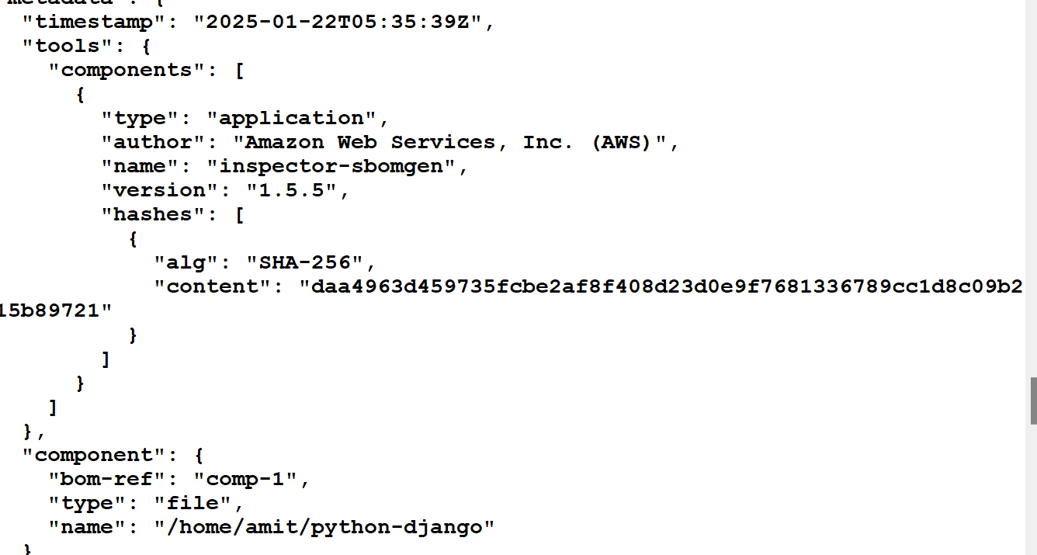
lab
Scan sample code from python

Slide 13



